Slide 1

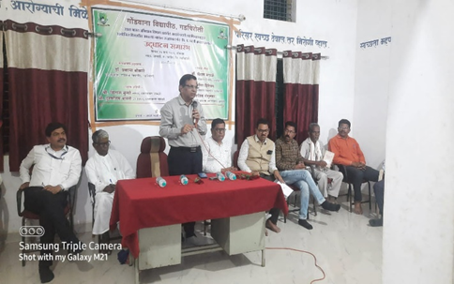
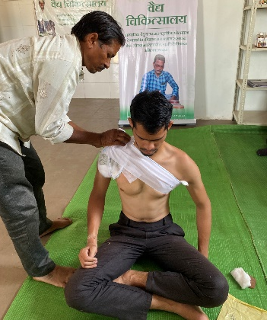
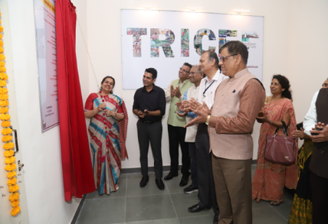
Best Practices Adopted by Gondwana University, Gadchiroli
First Year Under-graduate Programme (FYUGP)
  Vidyapeeth Aaplya Gavat
  Bachelor of Business Administration (Forest Management)
Indigenous Medicinal Knowledge
  Promotion of Traditional Healing Practices-Vaidya Chikitsalay, Digital Documentation of Traditional Healers and Healing Practices-Vaidu Directory, Documentation of Rare, Endangered and Threatened Medicinal Plants-Plant Checklist)
Inclusion of Ethnic Medicine in Curriculum
A 2-Credit Course of FYUGP on Indian Knowledge System (IKS)
4. Community Entrepreneurship through TRICEF
Facilitating innovation, creativity and incubation amongst students alumni and faculties
leading to social and business enterprise
5. Memorandum of Understanding with Vyakta University, Russia
Promoting academic and cultural exchange between 2 institutions through mutual assistance

Slide 2
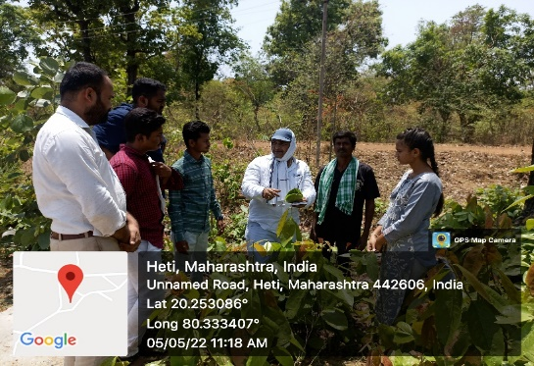
Best Practices Adopted by Gondwana University, Gadchiroli
6. Offering Dual Degree Program
Empowering students withy diverse skillset and an enriched academic journey by
seamlessly integrating 2 distinct disciplines)
7. Five Year Integrated Post Graduate Program
M.Sc. Data Science, Masters in Hospitality and Hotel Management, M.A. in Rural and Tribal
Development)
8. Internship Embedded Programs
Internship engagement for university students with multiple Government Departments,
MoU with Office of the District Collector)
9.Krantiveer Baburao Shedmake Kamwa Shika Yojna
University Earn and Learn Scheme as an apprenticeship to support skill development and
employability enhancement for underprivileged students

