Slide 1

QS I-Gauge
2nd Academic Excellence Conclave
FLAME University - Personal. Global. Empowering.

Slide 2

The FLAME Liberal Education Experience
2

Slide 3
Skills Employers Are Seeking For The 21st Century
Source: National Association of Colleges and Employers (NACE)

Slide 4
Abilities Cultivated In A Liberal Education
Think critically
Solve complex problems
Have and move towards realizing a ‘sense of purpose’ in life
Analyze effectively
Communicate persuasively
Leadership
Work independently & collaboratively
Resilience
Think from ‘First Principles’
Agility and flexibility to respond to challenges

Slide 5
FLAME Undergraduate Student Journey
Optional Year IV – Seamless Extension of the 3-Year Undergraduate Program
Harnesses and builds on the 3-Year UG Program.
Synthesizes learnings from the UG Program.
Goes deeper into the major area of study.
Gives opportunity to mandatorily complete a minor area of study.
Gives opportunity to complete a double major (subject to academic performance).
Connects the dots with the Interdisciplinary major project.
Culminates in a 4-year Honours degree.
Year 1
Explore
Year 2
Immerse
Year 4
Year 3
Imbibe
Connect

Slide 6
3-Year Undergraduate Program Overview
Offerings
Components
Foundation Courses
Exploration | Breadth of knowledge
Honing fundamental skills
Schools
Degrees
School of Liberal Education
School of Computing &
Data Sciences
School of Business
School of Communication
School of Design, Fine &
Performing Arts
B.A.
B.Sc.
BBA
BBA (Communications
Management)
Specialization Courses
Major + Minor | 350+ combinations
Depth of knowledge
Experiential Learning Courses
Immersion | Exposure to the real world
Social | Cultural & Historical | Professional
Majors & Minors
350+ Major & Minor combinations
Interdisciplinary majors in Comp Sc. & Design, Data Sc. &
Eco, Design Management
Optional 4th years honors
Value-Added Courses
Transferrable skills
Open Elective Courses
Sample and discover

Slide 7
4 Year Undergraduate Program Overview
Offerings
Components
Foundation Courses
Schools
Degrees
Exploration | Breadth of knowledge
Honing fundamental skills
B.A. (Hons.)
B.Sc. (Hons.)
BBA (Hons)
BBA(Communications
Management) (Hons)
B.Des (Experience Design)*
School of Liberal Education
School of Computing &
Data Sciences
School of Business
School of Communication
School of Design, Fine &
Performing Arts
Specialization Courses
Major + Minor | 310+ combinations
Depth of knowledge
Experiential Learning Courses
Majors & Minors
Immersion | Exposure to the real world
Social | Cultural & Historical | Professional
310+ Major & Minor combinations
Interdisciplinary majors in Comp Sc. (Honours),
Comp Sc. & Design, Data Sc. & Eco, Design Management
*B.Des is a 4 years degree program
Interdisciplinary Project
Connect the dots | Interdisciplinary Major Project, Graduation Project
Open Elective Courses
Sample and discover

Slide 8

Explore and Prepare For Life
Fundamental skill development
1. Academic Writing
5. Introduction to Applied Ethics
Introduction to prominent ethical theories and their application in real life situations
Extensive writing exercises that help evolve a cohesive and effective writing style
1
8
2. Critical Reasoning
6. Financial Literacy
Critically evaluate a problem with perspectives from different disciplines
2
7
Provides exposure to personal finance tools and techniques to effectively manage available financial resources
Foundation Core
Courses
3. Public Speaking
7. Intro to Environmental Studies
Enables communication with clarity and conviction
3
6
Develop deeper understanding and empathy for the natural environment
4. Digital Literacy
4
5
8. Mental Models Framework for thinking
Exposure to cutting edge information technology tools and solutions
Big ideas from different disciplines inculcating habits of thinking

Slide 9
Explore
Focused yet flexible interdisciplinary choices
Universes of Knowledge - Breadth
Social Sciences
5
Humanities
Economics, Sociology Psychology, Political Science, Public Policy, Anthropology, Archaeology, Business, amongst others
2
Literature, History, Cultural Studies, Philosophy, Art History, Communication, amongst others
1
Physical & Natural Sciences
3
Mathematics, Statistics, Physics, Biology, Chemistry, Computer Science, Geology, amongst others
5
Global Studies
4
Foreign languages like German, French Japanese, Spanish, Mandarin, Persian and some select Indian languages
Fine & Performing Arts
Visual Art, Sculpture, Theatre, Dance, Design and Music

Slide 10
Pursue Your Passion
Gain deeper understanding
Combine two disciplines
Unique opportunity to focus on two areas of specialization.
350+ major-minor combinations
Flexibility to straddle interests in distinct disciplines leads to interesting combinations.

Slide 11
Specialization Areas
3 or 4 -Year Degrees
Unique combinations where learning is at the fore front and degree is incidental
B.A.
BBA
BBA Communications Management
Economics | Psychology | Literary & Cultural Studies | International Studies | Environmental Studies | Journalism | Public Policy | Sociology
Finance | Marketing | Human Resources | Operations | Business analytics | Entrepreneurship | General Management | Design Management (IM)
Advertising & Branding | Digital Marketing & Communications | Film & Television Management | Communication Studies
B.Sc.
Applied Mathematics | Computer Science | Data Sc. And Eco (IM) | Computer Science and Design (IM)
Dance Music, Design, Philosophy and theater & performance studies are offered as minors

Slide 12
350 + Possible Major-Minor Combinations | 3-Year Undergraduate Program
Majors Minors | Finance | Marketing | Operations | Business Analytics | Entrepreneurship | HRM | LCS | AM | Public Policy | Psychology | ADBR | DMAC | FTV | Journalism | EVS | Computer Science | Int.St | Sociology | Economics | Philosophy | Dance | Music | Theatre & Performance Studies | Design | Possible Minors
Finance |  |  |  |  |  |  |  |  |  |  |  |  |  |  |  |  |  |  |  |  |  |  |  |  | 17
Marketing |  |  |  |  |  |  |  |  |  |  |  |  |  |  |  |  |  |  |  |  |  |  |  |  | 15
Operations |  |  |  |  |  |  |  |  |  |  |  |  |  |  |  |  |  |  |  |  |  |  |  |  | 17
B. Analytics |  |  |  |  |  |  |  |  |  |  |  |  |  |  |  |  |  |  |  |  |  |  |  |  | 17
Entrep. |  |  |  |  |  |  |  |  |  |  |  |  |  |  |  |  |  |  |  |  |  |  |  |  | 17
HR Manag. |  |  |  |  |  |  |  |  |  |  |  |  |  |  |  |  |  |  |  |  |  |  |  |  | 16
Gen. Manage |  |  |  |  |  |  |  |  |  |  |  |  |  |  |  |  |  |  |  |  |  |  |  |  | 16
Lit & Cultl Studies |  |  |  |  |  |  |  |  |  |  |  |  |  |  |  |  |  |  |  |  |  |  |  |  | 16
Appl.. Math |  |  |  |  |  |  |  |  |  |  |  |  |  |  |  |  |  |  |  |  |  |  |  |  | 21
Public Policy |  |  |  |  |  |  |  |  |  |  |  |  |  |  |  |  |  |  |  |  |  |  |  |  | 21
Psychology |  |  |  |  |  |  |  |  |  |  |  |  |  |  |  |  |  |  |  |  |  |  |  |  | 21
Adve & Branding |  |  |  |  |  |  |  |  |  |  |  |  |  |  |  |  |  |  |  |  |  |  |  |  | 17
Digital Mkt & Com |  |  |  |  |  |  |  |  |  |  |  |  |  |  |  |  |  |  |  |  |  |  |  |  | 17
Film & TV Management |  |  |  |  |  |  |  |  |  |  |  |  |  |  |  |  |  |  |  |  |  |  |  |  | 18
Comm. St |  |  |  |  |  |  |  |  |  |  |  |  |  |  |  |  |  |  |  |  |  |  |  |  | 18
Journalism |  |  |  |  |  |  |  |  |  |  |  |  |  |  |  |  |  |  |  |  |  |  |  |  | 18
Environmental Studies |  |  |  |  |  |  |  |  |  |  |  |  |  |  |  |  |  |  |  |  |  |  |  |  | 18
Int. Studies |  |  |  |  |  |  |  |  |  |  |  |  |  |  |  |  |  |  |  |  |  |  |  |  | 15
Sociology |  |  |  |  |  |  |  |  |  |  |  |  |  |  |  |  |  |  |  |  |  |  |  |  | 15
Economics |  |  |  |  |  |  |  |  |  |  |  |  |  |  |  |  |  |  |  |  |  |  |  |  | 15
Comp Sc. |  |  |  |  |  |  |  |  |  |  |  |  |  |  |  |  |  |  |  |  |  |  |  |  | 8
PLUS Interdisciplinary majors in Computer Science & Design | Data Science & Economics | Design Management

Slide 13

Specialization in Design
4 - Year Degree
Design interpreted through the lens of Liberal Education Approach
Major : Experience Design
Cross disciplinary approach with possible minors : Psychology | Literary & Cultural Studies | Marketing | Business analytics | Entrepreneurship
Foundation courses: First year focuses on building solid foundations for in demand skills
B.Des
Experience Design Curriculum
HUMAN BEHAVIOUR + BUSINESS + TECHNOLOGY = Design @FLAME
Inter-disciplinary in its truest sense, graduating students who have a strong hold and thorough understanding of Business, Technology & Psychology.

Slide 14
Subject Suggestions
Technology | Business | Humanities | Design
Fundamentals of Programming | Business of Design | Ethnographic Research & Writing | Design Thinking and Processes
Technology Tinkering | Systemic Thinking | Behaviour Design | Sketching and Prototyping
Data and Design | Service Design | Social Innovation | Communication Design
Immersive Media | Entrepreneurship & Business Models | Storytelling and Scenarios | Visual Design
Development Methods | Copywriting and Content Strategy | Probing Methodologies | Interaction Design
ML & AI | Strategic Planning | Cognitive Design | Advanced Design Methods
Data Analytics | Leadership | Critiquing & Evaluating | Advance UX
Technology Platforms | Design Process Management | Game Design | Zero UI
Speculative Design | Typography and Calligraphy | Design History | Makers Studio
Drawing Comics | Color Fundamentals |  | Information Design
Insight Development |  |  | Web Graphics
 |  |  | Physical UX

Slide 15




Experiential Learning
Developmental Activities Program
Discover India Program
Summer Internship Program
Interdisciplinary Major Project (Optional 4th Year)
Social Immersion
Historical & Cultural Immersion
Professional Immersion
Contextual Immersion
Students learn the value of social responsibility working with NGOs of their interest.
Students undertake field research projects to explore aspects of Indian history, culture and civilization.
Microcosm of what FLAME offers – interdisciplinary, research-focused, rigorous, inter-cultural communication, financial prudence, competitive and transformational education.
Students get hands-on professional working experience with internships in industry, business, think tanks, government, academia, etc.
At the intersections of different disciplines.
Students with diverse specializations work together to address an issue that is of relevance to society, technology, business or any other aspect of life.

Slide 16



10:1
student faculty ratio
Small class sizes
Effective mentoring
Knowledgeable advising
Valuable guidance
Close relationships
Meaningful discussions
Guru-Shishya Philosophy
FLAME University’s Guru-Shishya philosophy leads to deep connections between our passionate students and dedicated faculty ensuring individual attention and quality growth.
Detailed course evaluation and feedback
Deep insights
Well-being counselling
Collaborative efforts

Slide 17
Student Research
Assisting faculty research
Library resources
Research fund
Individual thesis & dissertations
Group collaborative projects
Notes:
Hyperlinks needed in certain places.
Research based learning is at the core of FLAME University. FLAME University identifies that and makes sure that research based learning is at the core of learning, student research, and resources that help in achieving that are all provided in abundance. Students can explore multiple research opportunities such as working as research assistants with faculty, working on data visualization projects such as the WageIndicator Foundation and others. The students also have access to resources such as Thomson Reuters, JSTOR, EBSCO, ProQuest and the Library of Mistakes amongst others. (click on the link to Library resources). Based in Edinburgh, The Library of Mistakes is a collection of every financial mistake that has been made in decades across companies. Students can learn from these mistakes and develop more qualified financial conjectures. FLAME University is the only partner of the Library of Mistakes outside UK.
For student research, the University Research Committee facilitates creation and development of strategies and options that students might adopt in order to address their knowledge and skill gaps and build capacity for more effective research and innovation. In its efforts to support enhancement of knowledge and intellectual growth of its students, the University supports various projects that the students take up under the guidance of their faculty. Some research work of our students can be seen here (click on the link to Individual thesis and dissertations).
Applied Mathematics Student Research Projects:
Managing the Zambezi river: The Kariba Dam, Alyssa O’Donohue, Calvin Gentry, Surbhi Lodha, Tirtha Patel, Mathematical Modelling course
Eradicating Ebola, Basudhara Choudhuri, Louis Kopp, Zheng Qu, Alec Nelson, Mathematical Modelling course
Garbage Patches in Subtropical Gyres: Tracking Particles from Source to Sink, Harshada Balasubramanian, Raghav Chadha, Salil Shinde, Mathematical Modelling course
Is it Sustainable? A Mathematical Model, Kyra Manjunath, Aditi Pasumarthy, Mathematical Modelling course
Environmental Studies Student Research Projects:
Tirtha Patel - Where Tourism meets Conservation: Translating Emotions into Actions https://www.currentconservation.org/issues/where-tourism-meets-conservation-translating-emotions-into-actions/
Smriti Jalihal - An annotated bibliography and summary of sea turtle satellite telemetry studies in the Indian Ocean and Southeast Asia https://www.iotn.org/iotn29-06-an-annotated-bibliography-and-summary-of-satellite-telemetry-studies-conducted-throughout-the-indian-ocean-and-south-east-asia/
Sanjana Singh - Nipah Virus: Effects of Urbanization and Climate Change. In Md. A. Rahman & R. Ahmadi (Eds.), International Institute of Chemical, Biological and Environmental Engineering. Paper presented at 3rd International Conference on Biological, Chemical and Environmental Sciences (BCES 2015), Kuala Lumpur, Malaysia, (pp. 64-68) | IICBEE | https://iicbe.org/upload/7575C0915051.pdf
International Relations Student Research Projects:
Jayanth Deshmukh (student):
Published research paper titled “Need for Space Law in India: Analyzing the Space Activities Bill” with Journal of Science Policy and Governance
Published research paper titled “Radical fundamentalism impeding successful policy intervention: Polio a case in point” with IIS Journal of Social Sciences
Authored an article titled “Beef Down: Implications of Beef Ban on Indian Communities” and published it with International Policy Digest
Co-authored an article titled “Never Again War? Tracing German Military Identity” and published it with International Policy Digest
Authored a research paper titled “Radical fundamentalism impeding successful policy intervention: Polio a case in point” and presented it at The Fourth Annual Seminar on Research in Social Sciences held in Mumbai, India
Psychology Student Research Projects:
Dr. Sairaj Patki and Aishwarya Sastry (student) - Gender Differences in Personality, Motivation and the Tendency to Follow Social Networking Trends among Indian Millennials
Abstract
With the availability of affordable and high-speed internet access on phones, social networking has reached far and wide. While some of the trends that emerge via these platforms have helped steer public movements and supported social causes, some lead to severe detrimental consequences like harm to psychological or physical wellbeing. The present study investigated personality traits and sources of motivation as factors related to the tendency to follow social networking trends on Facebook, Instagram and Snapchat among millennials. The sample included 133 respondents aged between 18-25 years. The findings suggested existence of some gender differences. While tendency to follow social networking trends was found to be related only with extraversion among females, it was found to be related to both extraversion and agreeableness among males. Also, tendency to follow social networking trends was found to be related with intrinsic motivation among females but with extrinsic motivation among males.
Economics Student Research Projects:
Medha Arora (Student) - Dissertation Work - The Role of Emotions and Mindfulness in Investment Decision Making - Medha Arora (Student)
Abstract
Traditional economic theories have always assumed that human beings make rational choices. However, reality may dictate otherwise. There are many factors that influence how one makes decisions, especially in the context of risk and uncertainty. Emotions are one such factor, and have proven to strongly affect risk attitudes. Mindfulness has also been associated with decision making and emotional regulation, although data for this finding is limited. Hence, this study aimed to investigate the role of emotions and mindfulness in investment decision making through the experimental method. Participants were randomly allocated into four emotional manipulation groups - positive affect, negative affect, neutral affect, and mindfulness. This was followed by an investment task, the results of which were analysed and compared based on the treatment condition. It was hypothesised that diverse emotional states would affect investment decisions differently, and that the mindfulness state would lead to the most rational investment behaviour. Results found that while investment choices between the four groups were not significantly different, higher overall positive affect significantly predicted lesser risk aversion compared to a negative state. The role of mindfulness as a potential anxiety buffer was also evident in a high global risk situation. Time and gender were also identified as important features impacting decision making.
Navneeth JK (Student) - Farmer Suicides in India- A Macro Perspective
Abstract
Agriculture is the soul of the Indian economy. Although the contribution of agriculture towards the GDP has been consistently declining, this sector still employs half of the India’s workforce. However, the agricultural sector in India is heavily distressed as evident from the large number of farmer suicides that have plagued the country over the last decade. So, what are the factors that lead farmers to commit this act? Is it the type of crops that they grow? Is it the high cost of inputs? Or is it a lack of infrastructure for farmers to sell their produce at a fair price? This paper aims to answer these questions. This paper uses a state level panel dataset from 2001-2013 to investigate the factors that affect farmer suicide in India. Preliminary results indicate irrigation and credit ratio negatively impacting farmer suicide while sown area affects farmer suicide positively. Moreover, we also find that consumer price positively affects farmer suicide in India. The results thus call for creating a stronger agricultural market in India.
Applied Mathematics Student Research Projects:
Managing the Zambezi river: The Kariba Dam, Alyssa O’Donohue, Calvin Gentry, Surbhi Lodha, Tirtha Patel, Mathematical Modelling course
Eradicating Ebola, Basudhara Choudhuri, Louis Kopp, Zheng Qu, Alec Nelson, Mathematical Modelling course
Garbage Patches in Subtropical Gyres: Tracking Particles from Source to Sink, Harshada Balasubramanian, Raghav Chadha, Salil Shinde, Mathematical Modelling course
Is it Sustainable? A Mathematical Model, Kyra Manjunath, Aditi Pasumarthy, Mathematical Modelling course
Environmental Studies Student Research Projects:
Tirtha Patel - Where Tourism meets Conservation: Translating Emotions into Actions https://www.currentconservation.org/issues/where-tourism-meets-conservation-translating-emotions-into-actions/
Smriti Jalihal - An annotated bibliography and summary of sea turtle satellite telemetry studies in the Indian Ocean and Southeast Asia https://www.iotn.org/iotn29-06-an-annotated-bibliography-and-summary-of-satellite-telemetry-studies-conducted-throughout-the-indian-ocean-and-south-east-asia/
Sanjana Singh - Nipah Virus: Effects of Urbanization and Climate Change. In Md. A. Rahman & R. Ahmadi (Eds.), International Institute of Chemical, Biological and Environmental Engineering. Paper presented at 3rd International Conference on Biological, Chemical and Environmental Sciences (BCES 2015), Kuala Lumpur, Malaysia, (pp. 64-68) | IICBEE | https://iicbe.org/upload/7575C0915051.pdf
International Relations Student Research Projects:
Jayanth Deshmukh (student):
Published research paper titled “Need for Space Law in India: Analyzing the Space Activities Bill” with Journal of Science Policy and Governance
Published research paper titled “Radical fundamentalism impeding successful policy intervention: Polio a case in point” with IIS Journal of Social Sciences
Authored an article titled “Beef Down: Implications of Beef Ban on Indian Communities” and published it with International Policy Digest
Co-authored an article titled “Never Again War? Tracing German Military Identity” and published it with International Policy Digest
Authored a research paper titled “Radical fundamentalism impeding successful policy intervention: Polio a case in point” and presented it at The Fourth Annual Seminar on Research in Social Sciences held in Mumbai, India
Psychology Student Research Projects:
Dr. Sairaj Patki and Aishwarya Sastry (student) - Gender Differences in Personality, Motivation and the Tendency to Follow Social Networking Trends among Indian Millennials
Abstract
With the availability of affordable and high-speed internet access on phones, social networking has reached far and wide. While some of the trends that emerge via these platforms have helped steer public movements and supported social causes, some lead to severe detrimental consequences like harm to psychological or physical wellbeing. The present study investigated personality traits and sources of motivation as factors related to the tendency to follow social networking trends on Facebook, Instagram and Snapchat among millennials. The sample included 133 respondents aged between 18-25 years. The findings suggested existence of some gender differences. While tendency to follow social networking trends was found to be related only with extraversion among females, it was found to be related to both extraversion and agreeableness among males. Also, tendency to follow social networking trends was found to be related with intrinsic motivation among females but with extrinsic motivation among males.
Economics Student Research Projects:
Medha Arora (Student) - Dissertation Work - The Role of Emotions and Mindfulness in Investment Decision Making - Medha Arora (Student)
Abstract
Traditional economic theories have always assumed that human beings make rational choices. However, reality may dictate otherwise. There are many factors that influence how one makes decisions, especially in the context of risk and uncertainty. Emotions are one such factor, and have proven to strongly affect risk attitudes. Mindfulness has also been associated with decision making and emotional regulation, although data for this finding is limited. Hence, this study aimed to investigate the role of emotions and mindfulness in investment decision making through the experimental method. Participants were randomly allocated into four emotional manipulation groups - positive affect, negative affect, neutral affect, and mindfulness. This was followed by an investment task, the results of which were analysed and compared based on the treatment condition. It was hypothesised that diverse emotional states would affect investment decisions differently, and that the mindfulness state would lead to the most rational investment behaviour. Results found that while investment choices between the four groups were not significantly different, higher overall positive affect significantly predicted lesser risk aversion compared to a negative state. The role of mindfulness as a potential anxiety buffer was also evident in a high global risk situation. Time and gender were also identified as important features impacting decision making.
Navneeth JK (Student) - Farmer Suicides in India- A Macro Perspective
Abstract
Agriculture is the soul of the Indian economy. Although the contribution of agriculture towards the GDP has been consistently declining, this sector still employs half of the India’s workforce. However, the agricultural sector in India is heavily distressed as evident from the large number of farmer suicides that have plagued the country over the last decade. So, what are the factors that lead farmers to commit this act? Is it the type of crops that they grow? Is it the high cost of inputs? Or is it a lack of infrastructure for farmers to sell their produce at a fair price? This paper aims to answer these questions. This paper uses a state level panel dataset from 2001-2013 to investigate the factors that affect farmer suicide in India. Preliminary results indicate irrigation and credit ratio negatively impacting farmer suicide while sown area affects farmer suicide positively. Moreover, we also find that consumer price positively affects farmer suicide in India. The results thus call for creating a stronger agricultural market in India.

Slide 18
FLAME Summer Immersion Program
For High-School Students – 9th, 10th & 11th Grade
Build a strong foundation to succeed in college and beyond
Contemporary and relevant interdisciplinary academic and non-academic modules that go beyond high-school programs
Examples of some modules include: Critical Thinking, The Biology and Conservation of Sea Turtles in India, Climate Change and Pandemics, Digital Footprints, Into the Mind of the Joker, Learn Accounting Using the Game of Monopoly, Data Visualization, Programming and Creative Writing
Embrace the spirit of FLAME University’s liberal education ethos

Slide 19

Global Collaborations
University of British Columbia
York University
King’s University College
Sciences Po
IE University
Frankfurt School of
Finance & Management
DHBW
Library of Mistakes
WageIndicator
Wellesley College
Amherst College
Babson Collaborative
Yale University
Indiana University Bloomington
Kelley School of Business
Boston University
University of California – Davis
Worcester Polytechnic Institute
Global Liberal Arts Alliance
CFA University Affiliation
College Board
Center for Southeast Asian Studies, National Chengchi University
FLAME

Slide 20
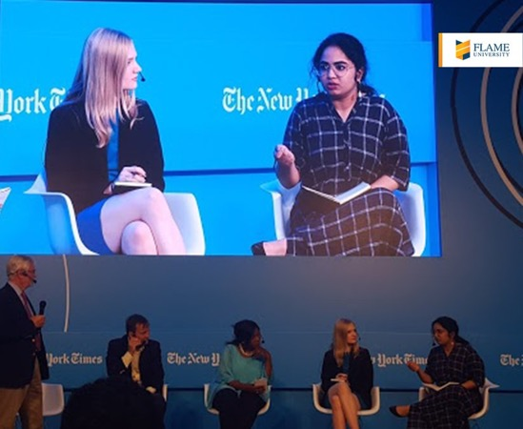
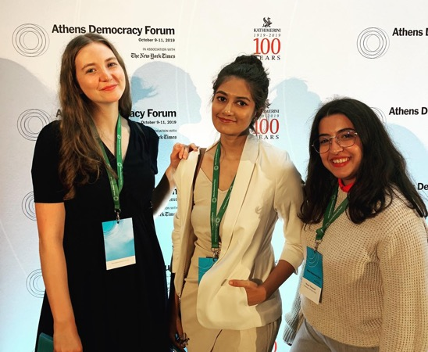
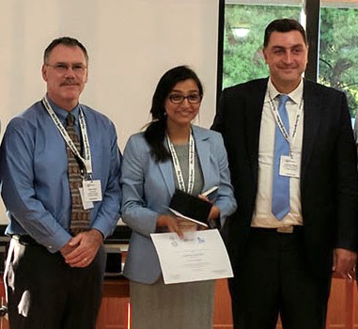
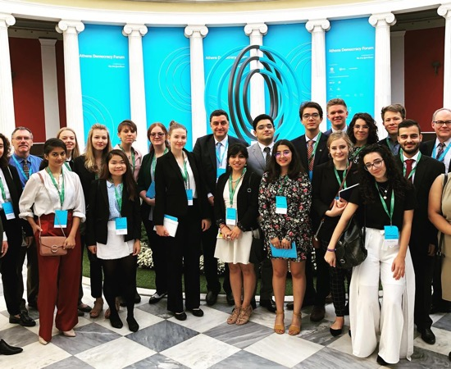
Global Immersion
Some examples of conferences and research opportunities
Conferences
Research
Athens Democracy Forum in association with The New York Times
Undergraduate students participate in the annual Athens Democracy Forum in Athens, Greece with over 500 international delegates from more than 40 countries. The Forum brings senior New York Times journalists together with international business leaders, policy makers, academics and experts to discuss the state of democracy with a focus on new solutions.
Association with WageIndictor Foundation, Netherlands
Undergraduate students support the global WageIndicator system, working on data analysis and data journalism, targeting different occupational groups in India and abroad with tailor-made wage and labour law information. This provides a platform to learn and upgrade skills needed to convert data into easy to read mini-stories for web visitors and mobile phone users, creating stills, graphs and videos.

Slide 21
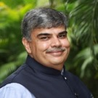
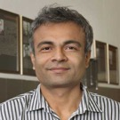
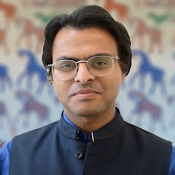


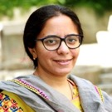

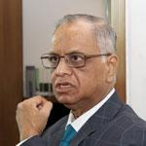
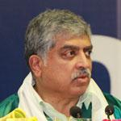
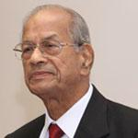



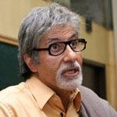
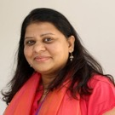

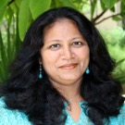
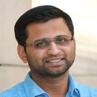


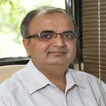

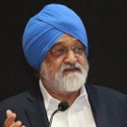
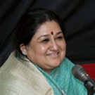


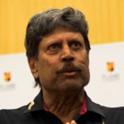
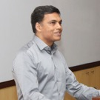
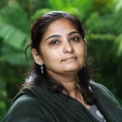
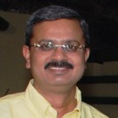
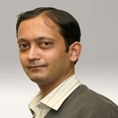
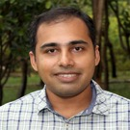

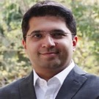
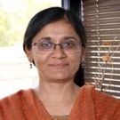
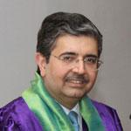

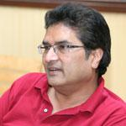
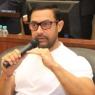
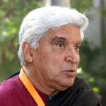

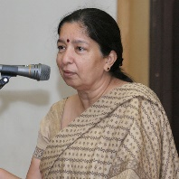
Thought Leaders
Esteemed faculty scholars
Distinguished guest speakers
Some of the acclaimed institutions where our faculty come from:
University of Cambridge, UK
Stanford University, USA
University of Chicago, USA
Brown University, USA
University of California, USA
University of Michigan, USA
University of Southern California, USA
London School of Economics and Political Science, UK
Babson College, USA
Pennsylvania State University, USA
University of North Carolina, USA
University of Texas at Austin, USA
NUS, Singapore
University College of London, UK
King’s College London, UK
Macquarie University, Australia
IIT – Bombay, Delhi, Madras
IIM – Ahmedabad, Calcutta
Indian Statistical Institute, Calcutta
FLAME University hosts many renowned national and international personalities:
Narayana Murthy
Nandan Nilekani
Suresh Prabhu
Montek Singh Ahluwalia
Shubha Mudgal
Shikha Sharma
Sanjeev Sanyal
Anil Kumble
M.S. Dhoni
Russell Napier
Deepak Parekh
Uday Kotak
K.V. Kamath
Amitabh Bachchan
Rakesh Jhunjhunwala
Ronnie Screwvala
Prasoon Joshi
A
B

Slide 22
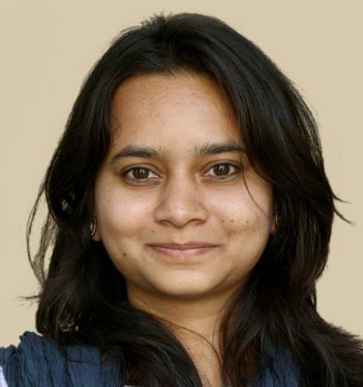

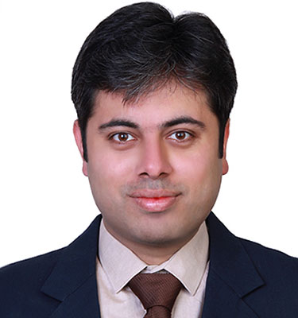
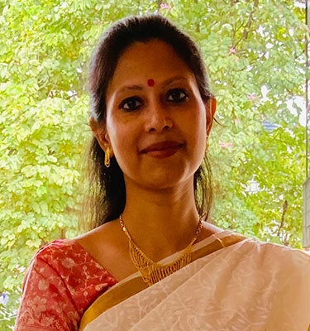
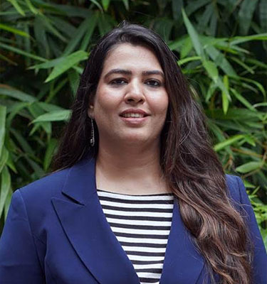
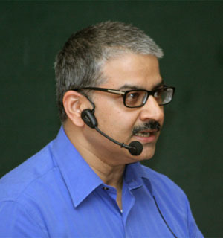


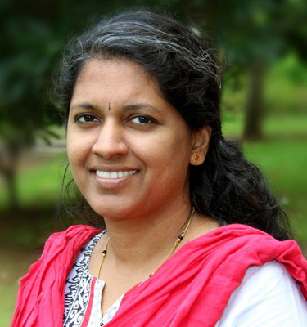
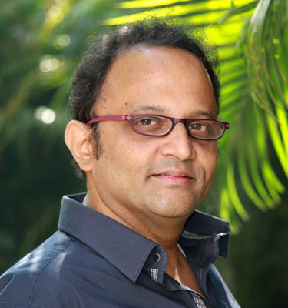

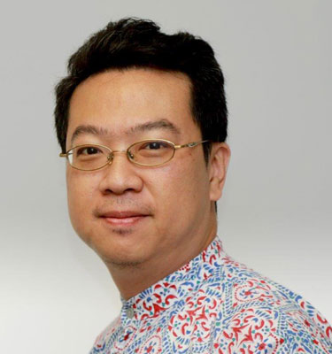
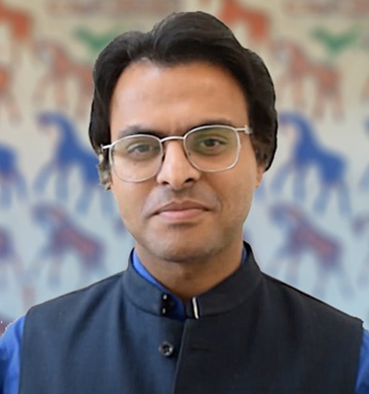
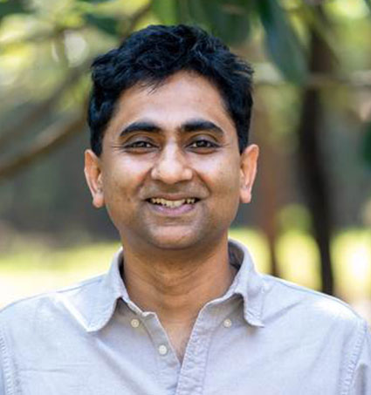

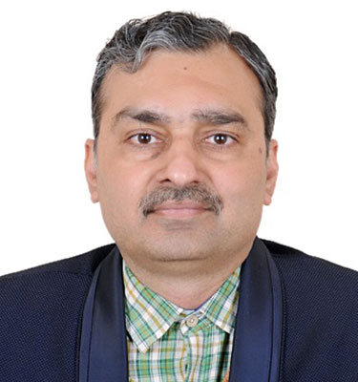
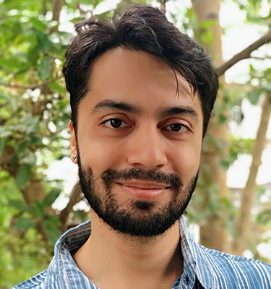
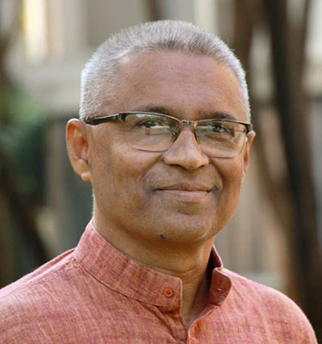
Some Notable Scholars – A Glimpse
Dr. Juhi Sidharth
PhD: University of Cambridge
Public Policy
Dr. Maya Dodd
PhD: Stanford University
Literary & Cultural Studies
Dr. Love Sarin
PhD: Brown University
Entrepreneurship
Dr. Sreeparna Chattopadhyay
PhD: Brown University
Sociology
Dr. Ramna Walia
PhD: University of Texas - Austin
Film & Television Management
Prof. Sanjay Bakshi
MSc: London School of Economics
Finance
Dr. Andrea Phillott
PhD: Central Queensland Uni.
Environmental Studies
Dr. Michael Hatcher
PhD: Uni. of Southern California
Philosophy
Dr. Indrani Rao
PhD: UNC at Chapel Hill
Applied Mathematics
Dr. Aamod Sane
PhD: University of Illinois at UC
Computer Science
Dr. Heather Sottong
PhD: University of California - LA
Literary & Cultural Studies
Dr. Roger Liu
PhD: University of South Carolina
International Studies
Dr. Yugank Goyal
PhD: Erasmus Uni. Rotterdam
Public Policy
Dr. Kaushik Ramu
PhD: Uni. of Pennsylvania
Literary & Cultural Studies
Dr. Aparna Shankar
PhD: University of Leeds
Psychology
Dr. Swapnajit Chakraborti
PhD: IIM Indore
Business Analytics
Dr. Shreekant Deodhar
PhD: IISc Bangalore
Environmental Studies
Dr. Vinod Vidwans
PhD: IIT Bombay
Design

Slide 23




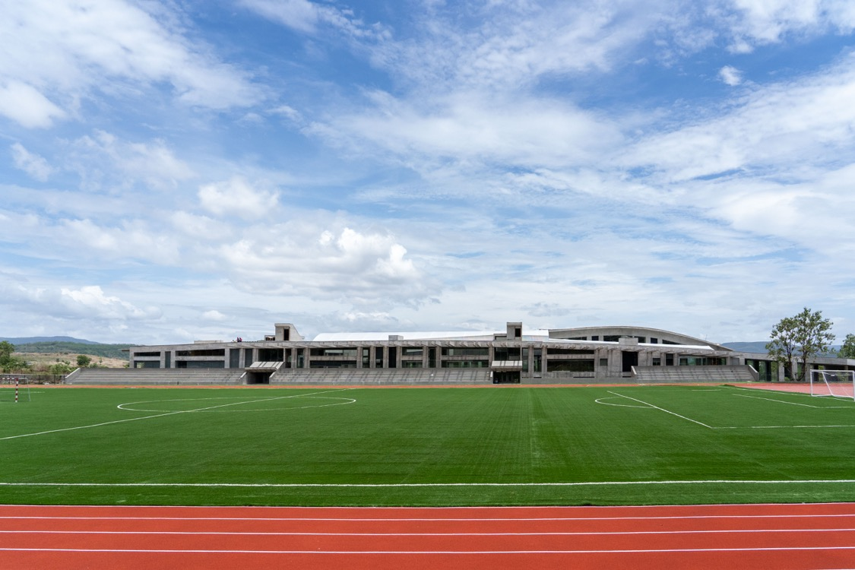
Global Campus Experience
World-class campus

Slide 24

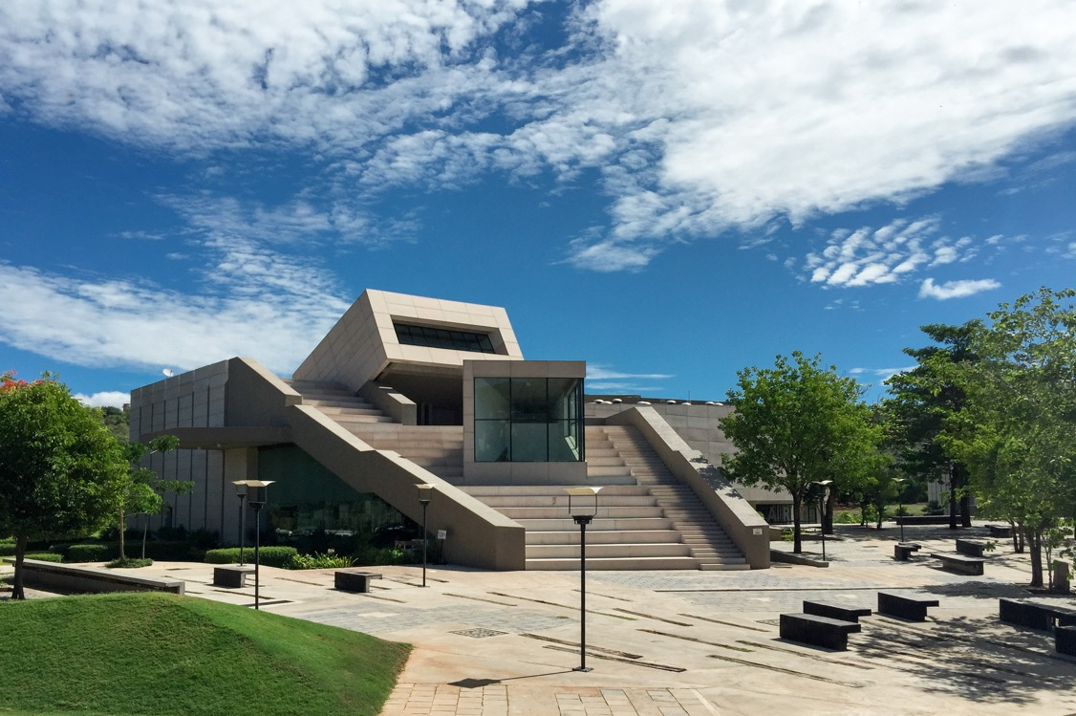
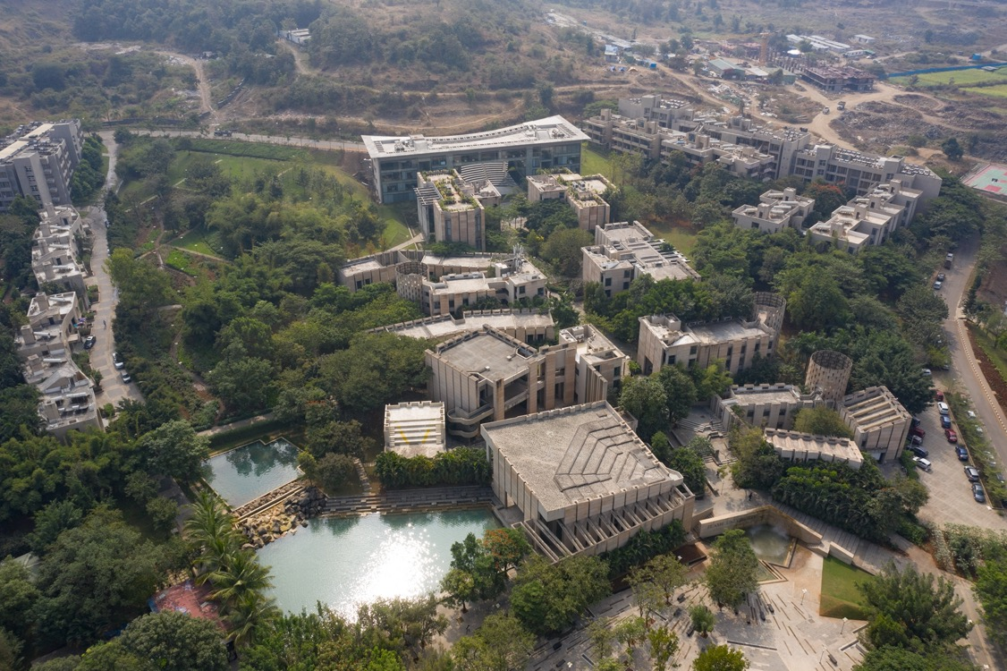
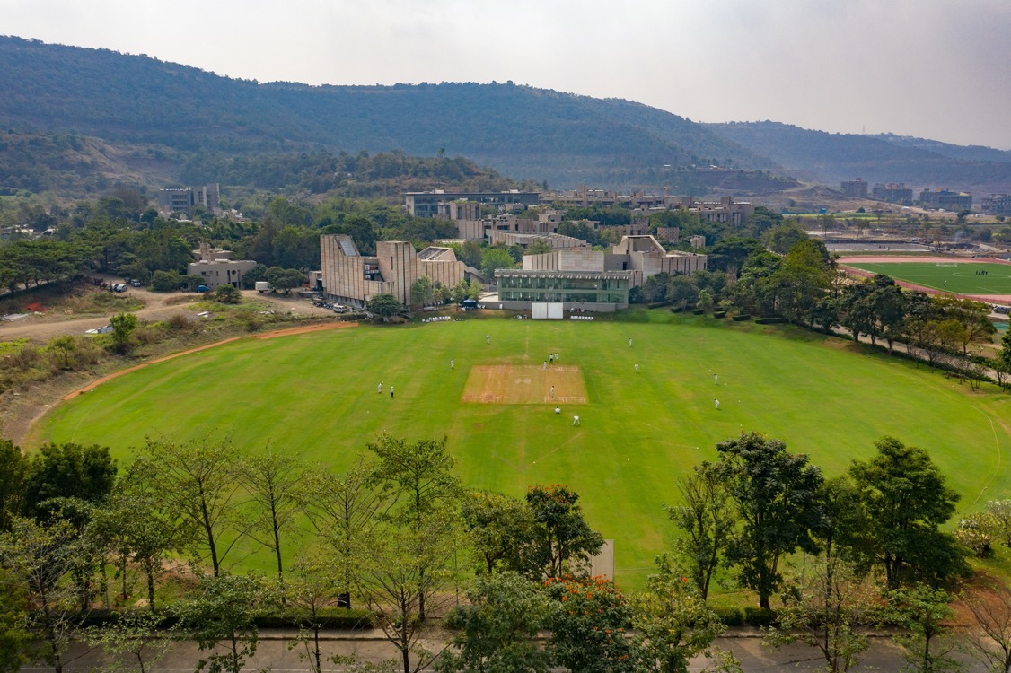

Global Campus Experience
World-class campus

Slide 25
Career Pathways
Why interdisciplinarity matters?
Connections between seemingly different disciplines for better decision-making. Some examples:
Finance
Draws from History, Psychology, Economics, Mathematics, Sociology amongst others.
Psychology
Integrates with Philosophy, Computer Science, Political Science, Economics, Biology amongst others.
Discipline II
Discipline III
2
3
Discipline I
1
4
Discipline IV
Economics
Closely linked with Sociology, Psychology, Political Science, Mathematics amongst others.
Journalism
Borrows from Literary & Cultural Studies, Public Policy, History, Sociology amongst others.
Computer Science
Interconnected with Psychology, Mathematics amongst others.
Entrepreneurship
Intersects with Psychology, Political Science, Economics, Sociology amongst others.

Slide 26
Alumni Achievements
Our alumni are going places…literally
Consulting | Tech | Financial Services | Media | Think Tanks | Consumer
Accenture | Amazon | American Express | BBC News | Carnegie India | Hindustan Unilever
Capgemini | BookMyShow | Barclays | Bloomberg Quint | Centre for Policy Research | IKEA
Deloitte | BYJU’s | BNP Paribas | CNBC TV-18 | DRDO | L’Oreal
E&Y | Cisco | BNY Mellon | Conde Nast | NITI Aayog | Louis Vuitton
KPMG | Cognizant | Citi India | FCB Ulka | World Bank | Nestle
McKinsey | CRED | Credit Suisse | Genesis Burson-Marsteller | United Nations | Nike
PwC | Google | CRISIL | Harper Collins | World Economic Forum | Nykaa
 | Hewlett Packard | DBS | J. Walter Thompson |  | OYO
 | Hotstar | Deutsche Bank | Leo Burnett |  | Pepsi Co
 | IBM | DSP Blackrock | Lowe Lintas |  | Swiggy
 | Infosys | Franklin Templeton | McCann Erickson |  | The Walt Disney Company
 | Intel | Goldman Sachs | Ogilvy |  | Titan
 | LinkedIn | HSBC | Penguin Random House |  | Uber
 | Microsoft | JPMorgan | Publicis |  | Zomato
 | Paytm | Morgan Stanley | Saatchi & Saatchi
 | Samsung | Thomson Reuters | The Economic Times
 | TCS | UBS | The New York Times

Slide 27
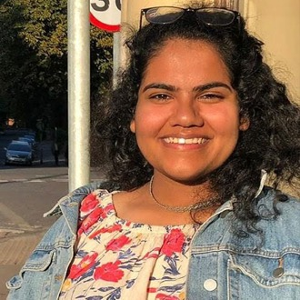
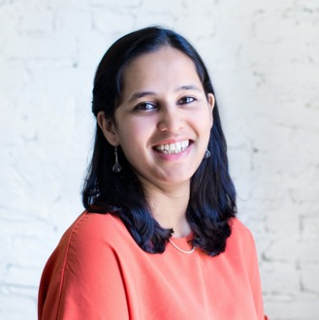










Alumni Achievements
Our alumni are going places…literally
Aarathi Ganesan
Major : Literary & Cultural Studies
Minor : International Studies
Masters : University of Oxford
Career Pathway : Journalism | Editor – The Bastion
Malvika Bhagwat
Major : Psychology
Minor : Literary & Cultural Studies
Masters : Harvard University
Career Pathway : EdTech | Director – Owl Ventures
Hemakshi Meghani
Major : Marketing
Minor : Literary & Cultural Studies
Masters : Harvard University
Career Pathway : Entrepreneurship | Co-founder – Indian School of Democracy
Shimul Bijoor
Major : Environmental Studies
Minor : Design
Masters : Yale University
Career Pathway : Environmental Management | Program Manager – Yale University
Tirth Manek
Major : Psychology
Minor : Music
Masters : University of Pennsylvania
Career Pathway : Organizational Development Consultant and Executive Coach
Nioshi Shah
Major : Psychology
Minor : Sociology
Masters : University of Chicago
Career Pathway : Research & Writing Fellow | The African American Policy Forum
Aditya Ashok Balu
Major : International Studies
Masters : The John Hopkins University
Career Pathway : Communications Specialist – United Nations
Vaishnavi Bala
Major : Finance
Minor : Economics
Masters : Columbia University
Career Pathway : Development Practice | IFC, World Bank
Rahul Bhatia
Major : International Studies
Masters : The George Washington University
Career Pathway : Foreign Policy Think Tank | Research – Carnegie India
Saumya Sampath
Major I : International Studies
Major II : Digital Marketing & Communications
Career Pathway : Pursuing postgraduate education | Fletcher School of Law & Diplomacy – Tufts University
Swetha Murali
Major : International Studies
Masters : The John Hopkins University
Career Pathway : Business Development | Executive – Airbus Defence and Space
Vishal George
Major : Economics
Minor : Mathematics
Masters : University of Warwick
Career Pathway : Behavioural Science | Head – Ogilvy NZ

Slide 28
Holistic Approach
What we look for?
Process
At FLAME, we value your entire experience. Our skilled admissions team takes your holistic achievements into consideration while reviewing your application.
While strong academic scores are important, we want to meet the person behind them and learn what they value and care for. We are looking for leaders, community builders, involved learners and critical thinkers. We are looking for students with diverse interests who can strengthen the connection between living and learning and participate in everything FLAME has to offer inside and outside of the classroom. We are looking for good communicators who can articulate their case for admission at FLAME.
Our students are well-rounded, inquiring, imaginative and expressive; and we want it no other way.
On your registered email you will receive the date & time of your FEAT
Write your SOP and submit the application
Upload your documents: educational & other achievements
5
6
Appear for FEAT – online examination
4
7
Pay the application fee, 2000 INR
3
8
Result is declared in 2 weeks
2
1
Fill your personal and educational details
Register on : https://www.flame.edu.in/admissions/apply & Start the Application
Notes:
Read/Explain

Slide 29
Scholarship & Financial Aid
I
Merit scholarships
II
Need-based financial aid
III
Special scholarships
IV
College Board India Scholars

