Slide 1
NEP 2020 Implementation

Slide 2
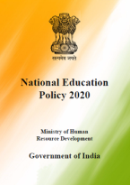
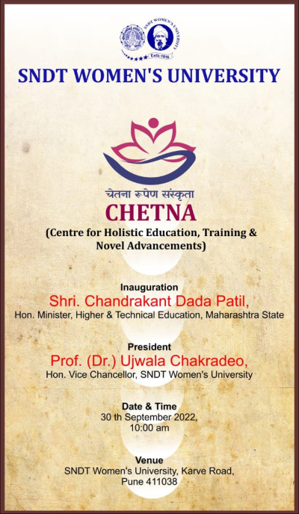
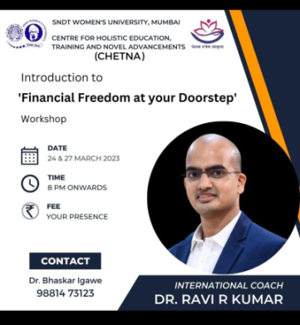
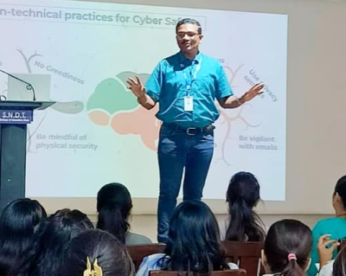
Centre for Holistic Education, Training and Novel Advancements (CHETNA)
A pool of need-based, Value-based, skill-based capacity-building add-on short-term courses
in collaboration with local, national, & international institutions
CHETNA
Language
Multi-disciplinary courses
Life skills Education
Teaching Learning & Pedagogy
Research
Technology
Environment Education
Community Outreach
Cultural Education
Courses launched (2022-23)
Python
Cyber safety
Financial Freedom at your Doorstep
Yog Parichay
100+ approved

Slide 3
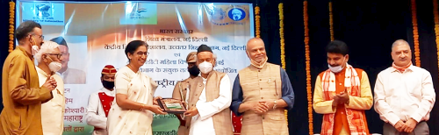
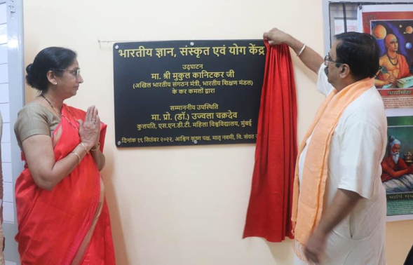
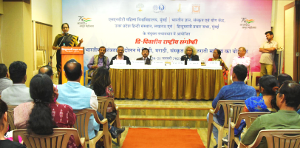
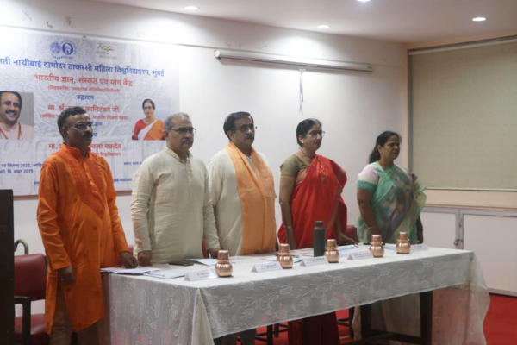
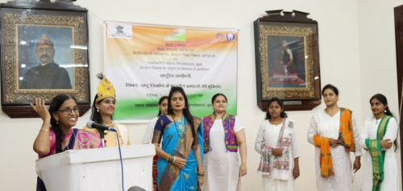
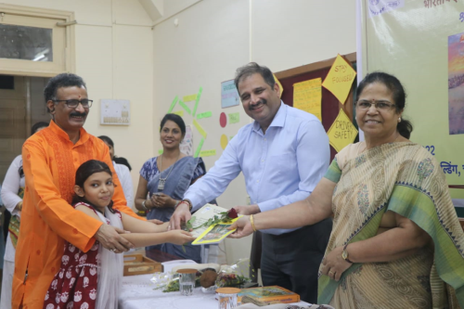
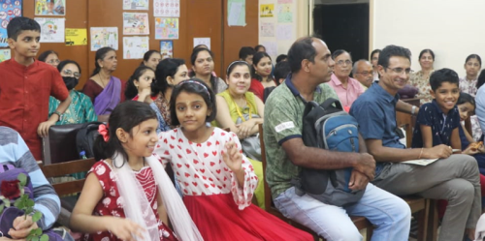
Bharatiya Gyan, Sanskrit & Yoga Centre

Slide 4
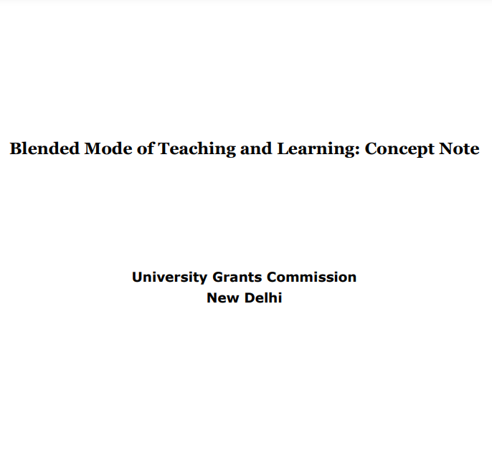
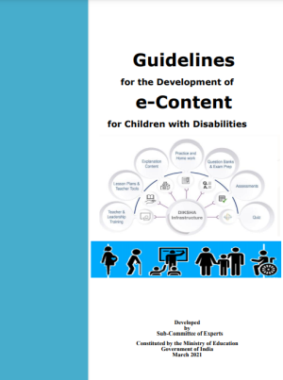
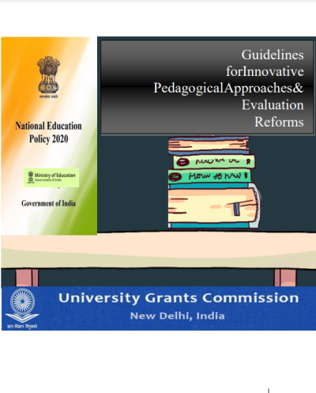
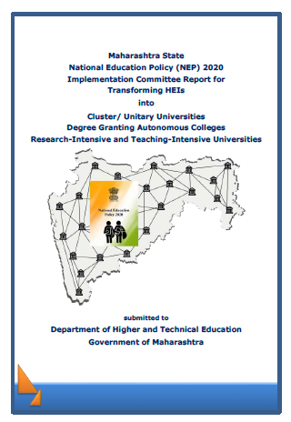

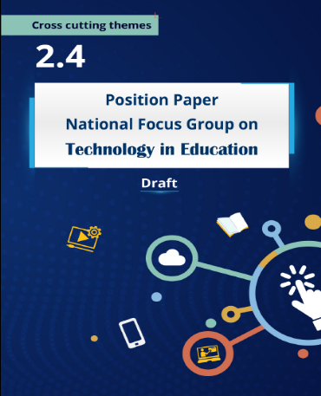
Contribution to NEP Implementation Committees
Prof. Vasudha Kamat
Former Vice-Chancellor,
SNDT Women’s University
Member
NEP-2020 Draft Committee
Prof. Ujwala Chakradeo
Vice-Chancellor,
SNDT Women’s University, Mumbai
Chairperson,
NEP Implementation Committee II
Prof. Jayashree Shinde
Head,
Dept. of Educational Technology
Prof. Sujata Bhan
Head,
Dept. of Special Education
Notes:
JS: Blended Learning & Innovative Pedagogy of UGC, National Focus group for Technology in Education of NCERT
Sbhan: Guidelines for eContent for Children with Disabilities of NCERT

Slide 5
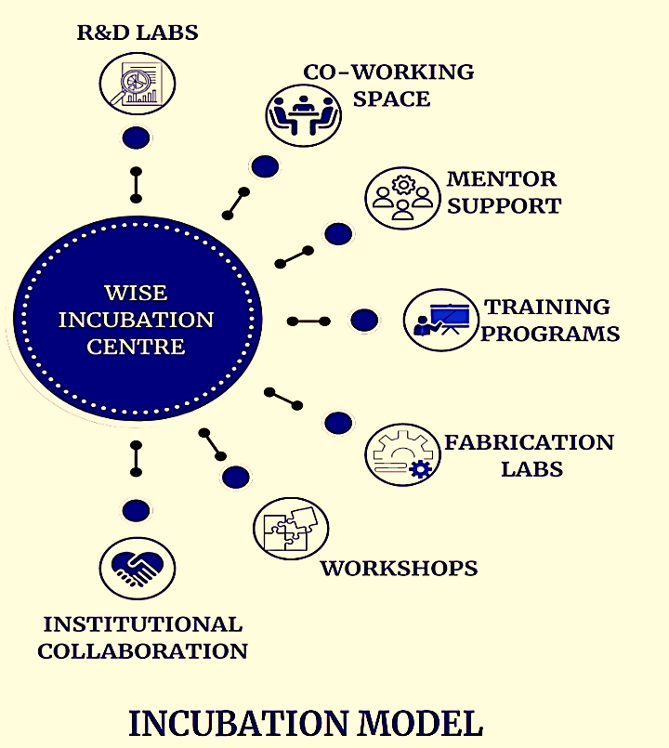









WISE
WISE Thrust Areas
Funding Partner
Social Entrepreneurship
Bio-Technology
Edu Tech
Water Technology
AI/ML/IOT/ICT/ Robotics
Health-Tech
Agri-Business
Fin–Tech
Fashion Design
Clean & Renewable Energy
Collaborators

Slide 6

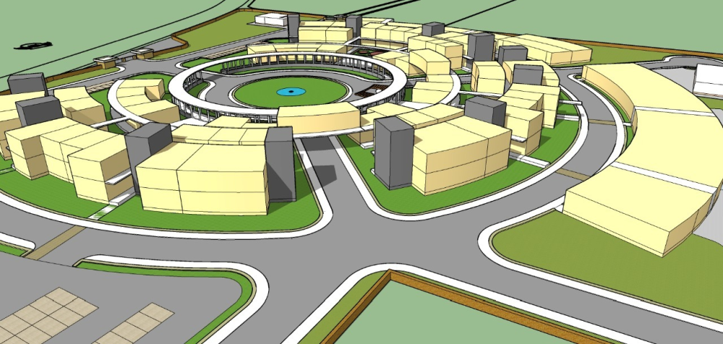
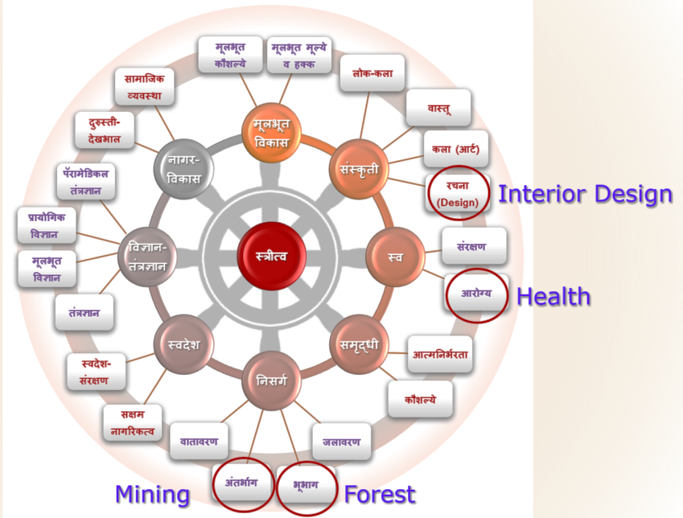
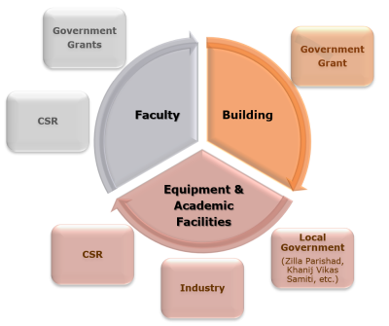
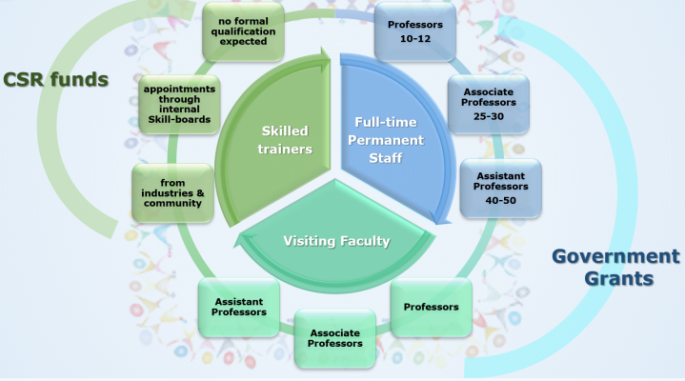
NEP-ready New Campus
Maharshi Karve Stree Sakshameekaran DnyanSankul,
Ballarpur, Chandrapur
50 acre
500 Crore

Slide 7
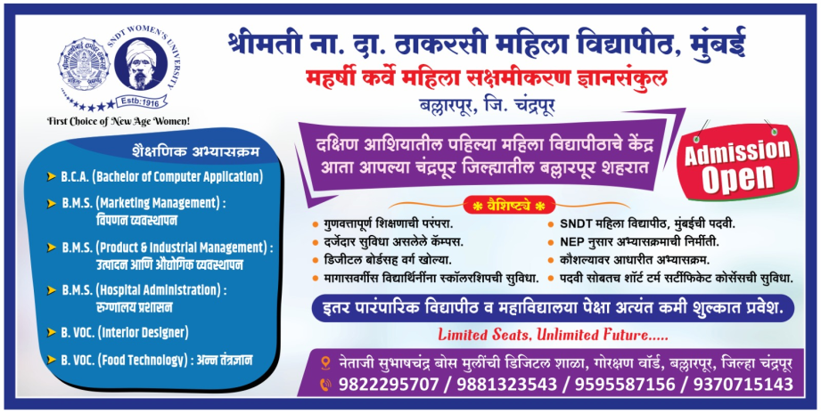
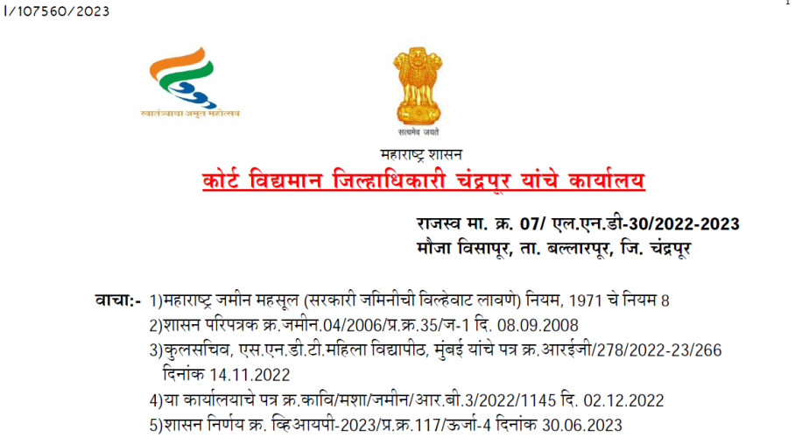
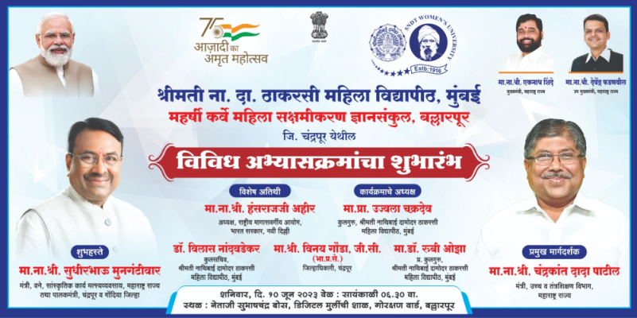
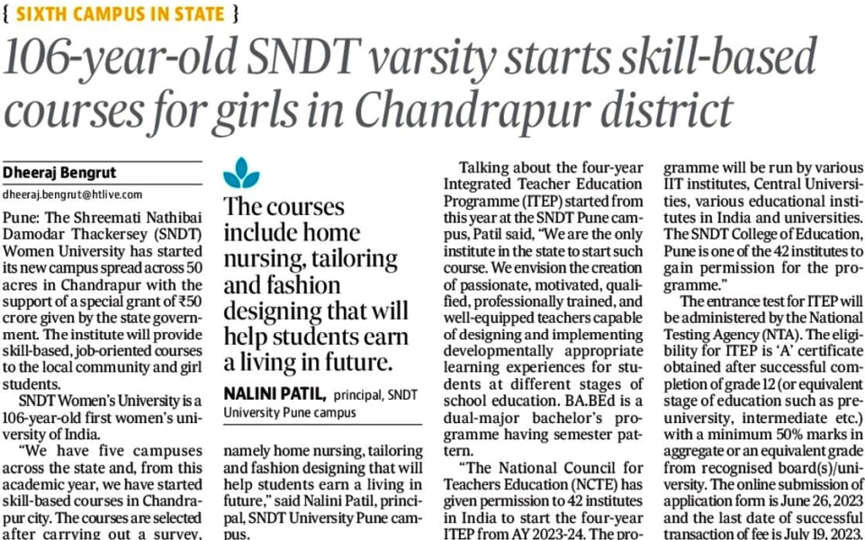
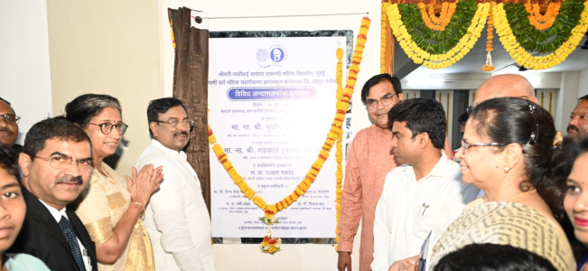
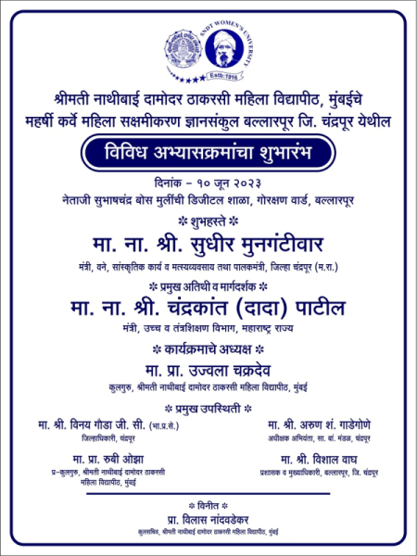
NEP-ready New Campus
Maharshi Karve Mahila Sakshameekaran Dnyansankul Chandrapur

